Slide 1

ASOR Guidebook App
How to Use - In Depth Guide with Photos

Slide 2
Downloading the App

Slide 3
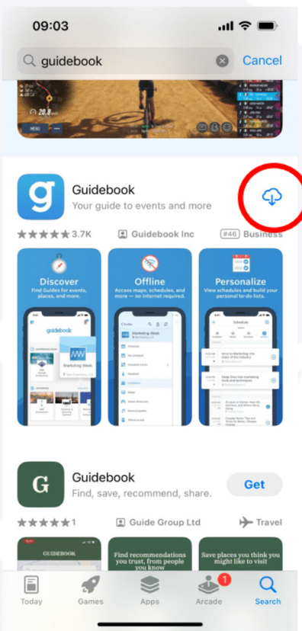
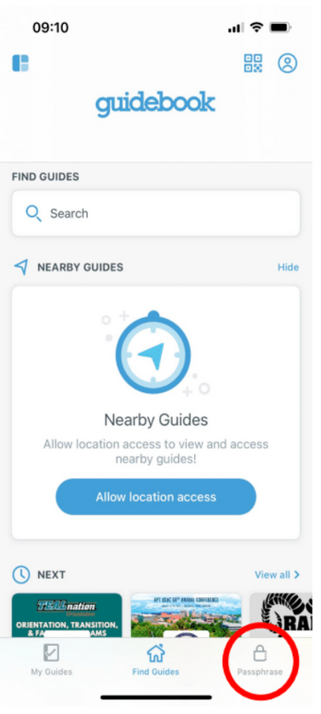
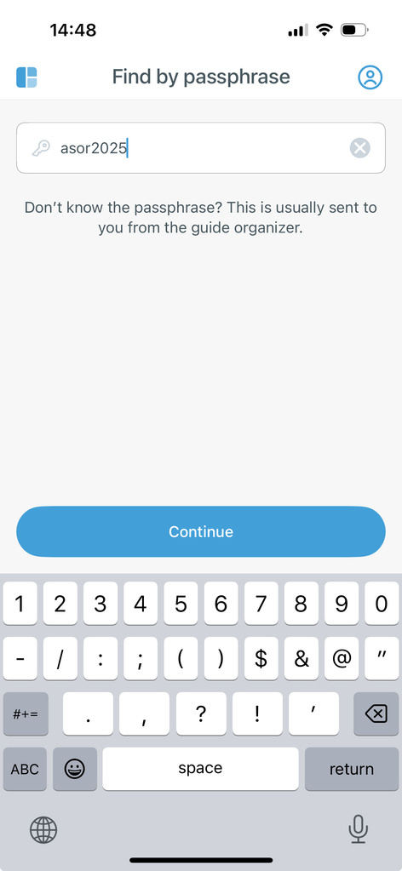
How to Download the App + Access the Guide
Navigate to the app store and search for “Guidebook”
A bright blue app with a lowercase “g” should appear
Download the app and open it on your mobile device
On the bottom of the landing page, there will be 3 icons: “My Guides”, “Find Guides”, and “Passphrase”
Click on “Passphrase”
Enter the guide passphrase: asor2025
The name of the guide itself is “ASOR 2025 Annual Meeting”
Download, then open the guide

Slide 4
Using the App

Slide 5
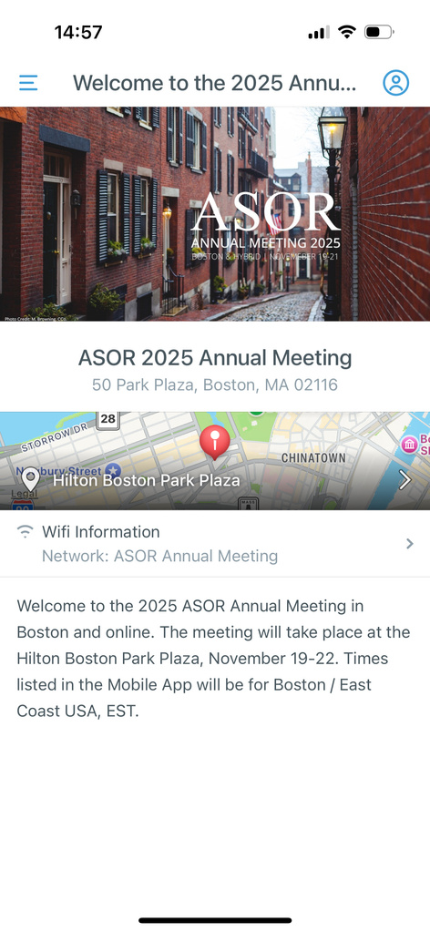
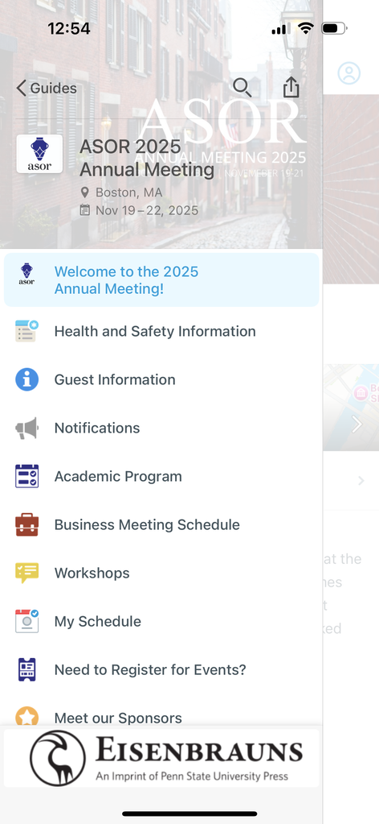
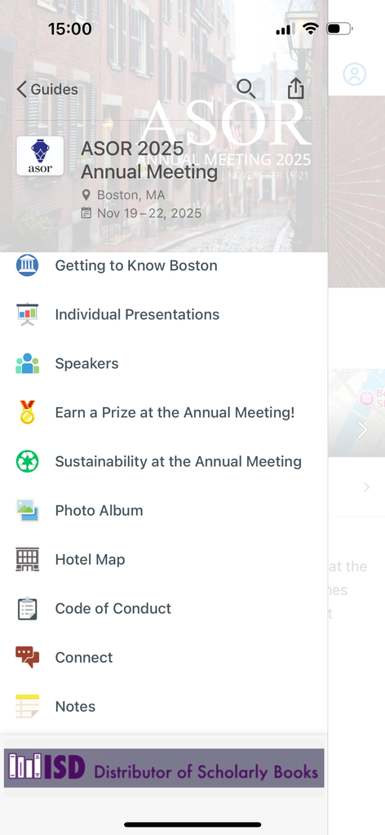
Welcome Page
The landing page will show the title, location, WiFi information, and a brief description of the Guide
To see the menu, click on the 3 parallel lines in the top left corder of the Guide
Use this icon to navigate back to the menu
This presentation will go through each of the menu items in detail
For a quick guide on how to access sessions and craft “My Schedule”, please refer to the Quick Info sheet here

Slide 6
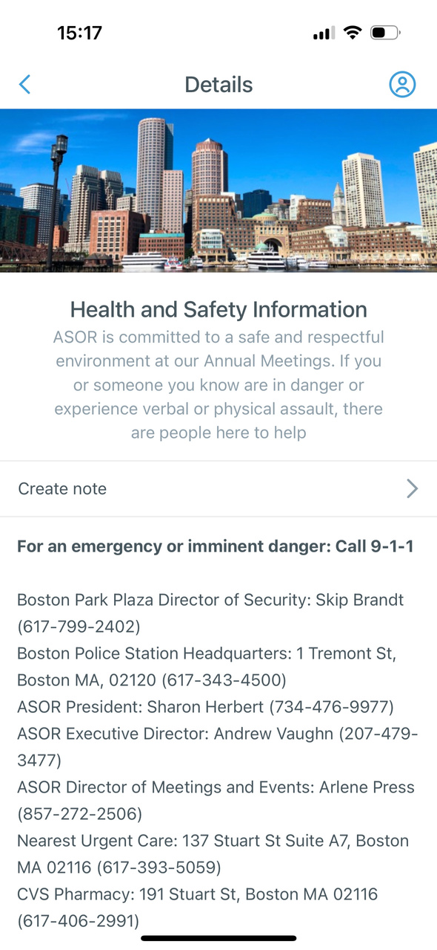
Health and Safety Information
This page lists emergency contacts, local police information, and other pertinent resources to ensure everyone’s safety and health

Slide 7
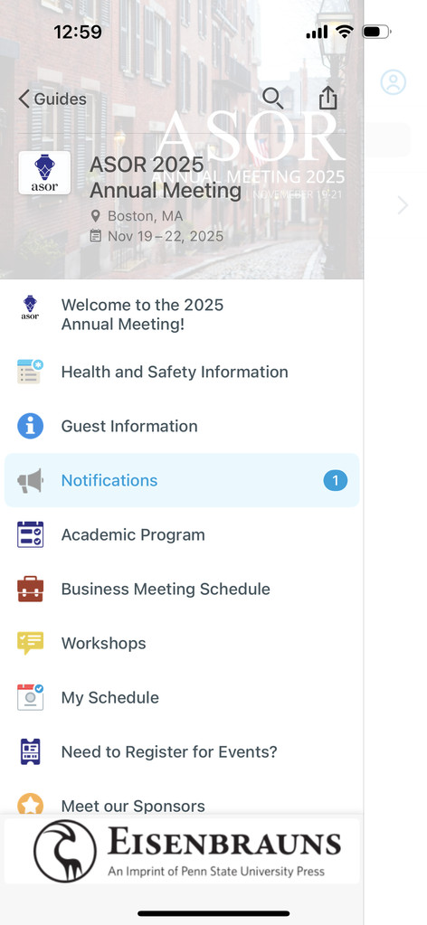
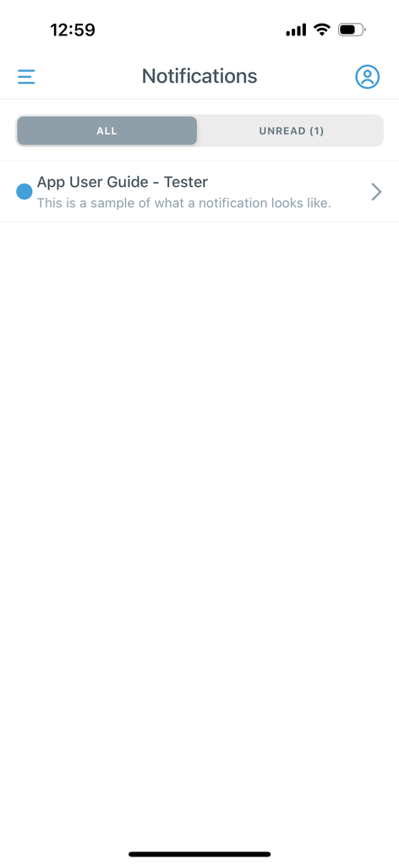
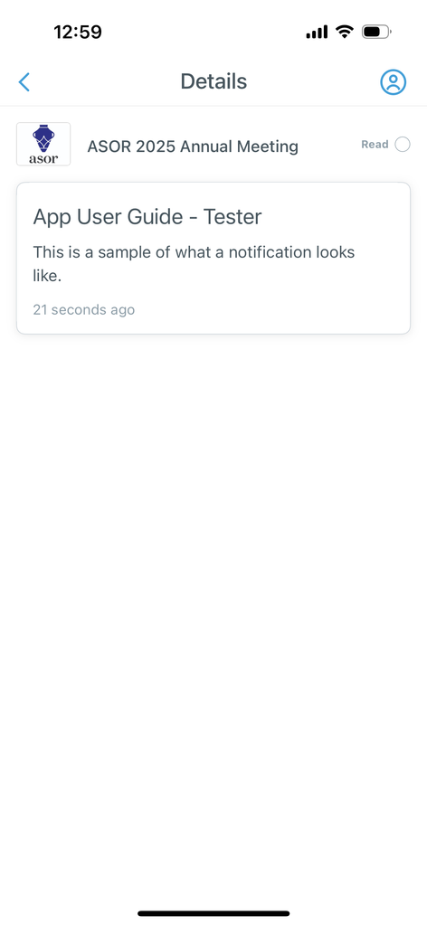
Notifications
This page is where all users will receive notifications regarding sessions, presentations, and events during the Annual Meeting
Last minute presentation/session changes, cancellations, and location changes will be announced via Notifications
You can check unread notifications with the “Unread” tab

Slide 8
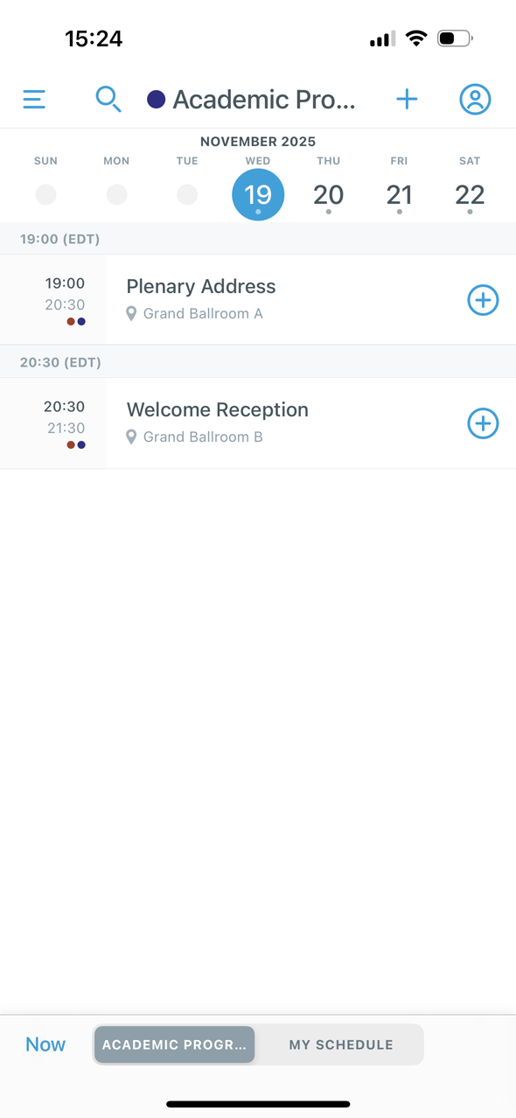
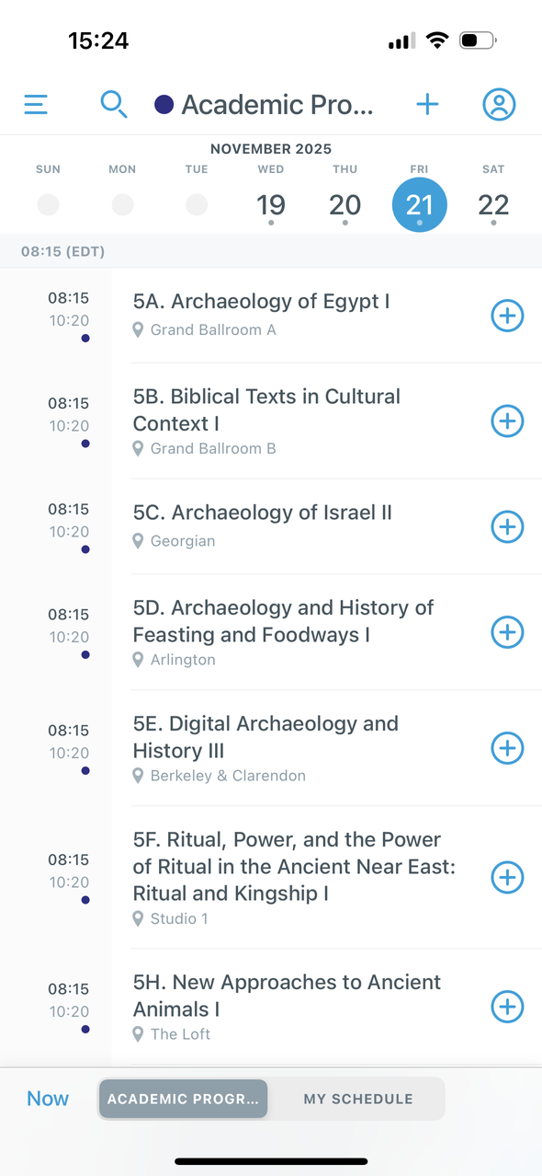
Academic Program
This is where users can view all the sessions/presentations during the Annual Meeting
Navigate between days using the dates at the top
The images to the right show Wednesday and Friday of the Annual Meeting
Scroll down to view all the sessions and event on each day
Virtual Presentations are marked with an asterisk (*) before the title.
Note: There is overlap between the Academic Program, the Business Meetings, and Workshops

Slide 9
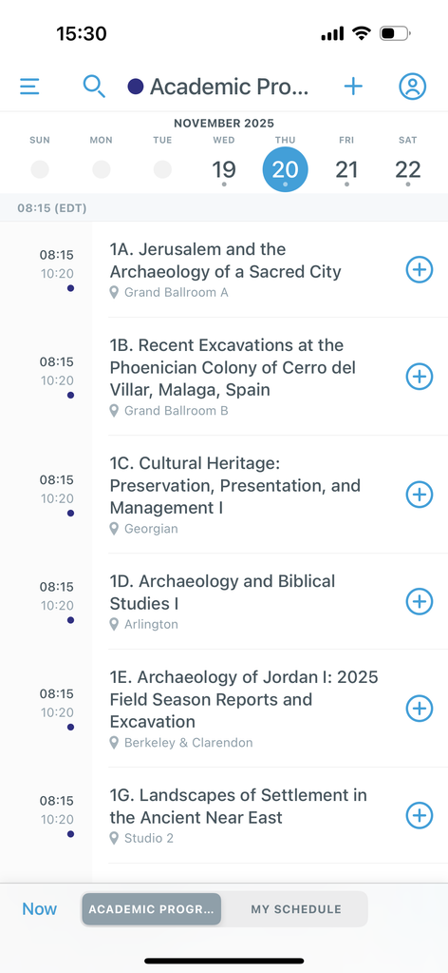
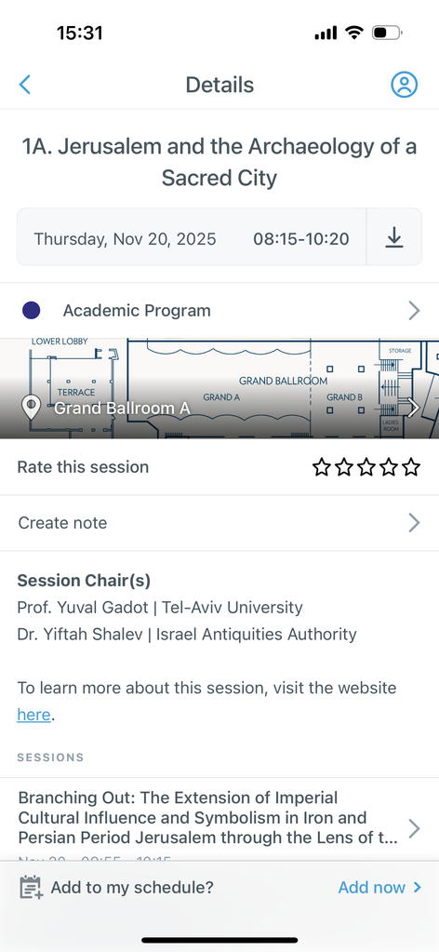
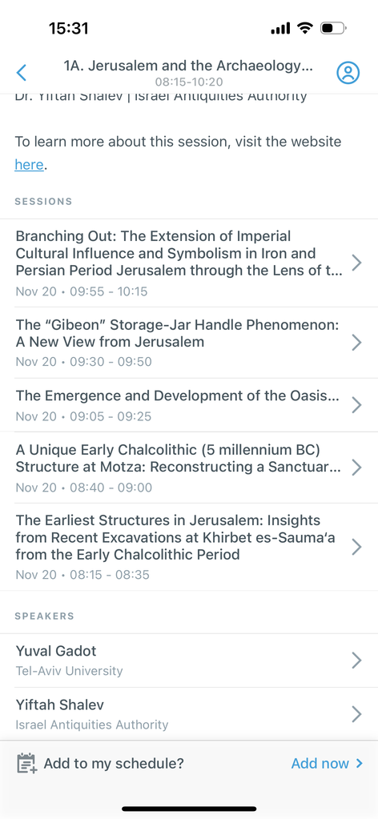
Academic Program
How to view Sessions:
Click on the session you want to view
The date, time, location, session chairs, a list of the individual presentations, and a list of speakers will populate
See the next slide on viewing individual presentations
To view sessions occurring live, click on the Now button on the main session, business, and workshop pages

Slide 10
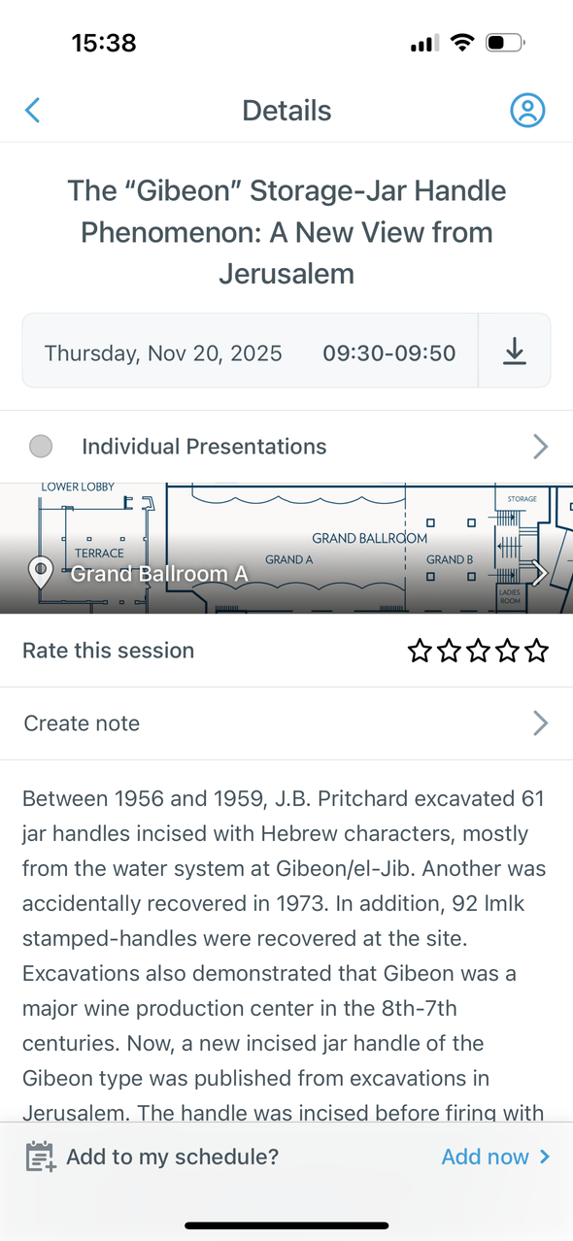
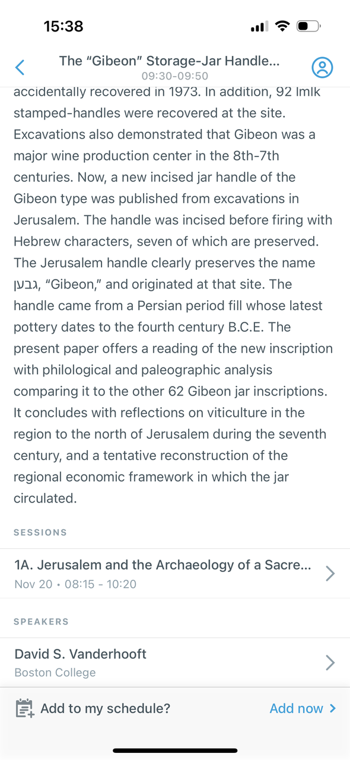

Academic Program
How to view Individual Presentations:
Click on the presentation you want to view
The date, time, location, abstract, and (co)authors will populate
date & time
location
abstract
(co)authors

Slide 11
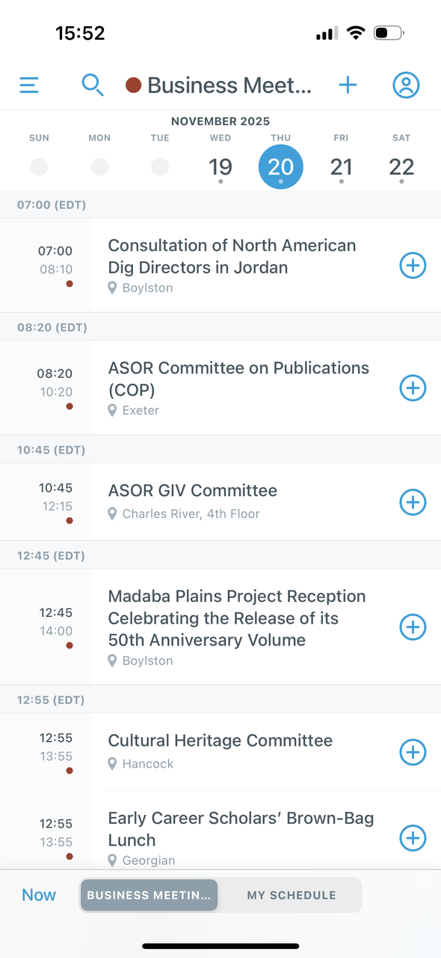
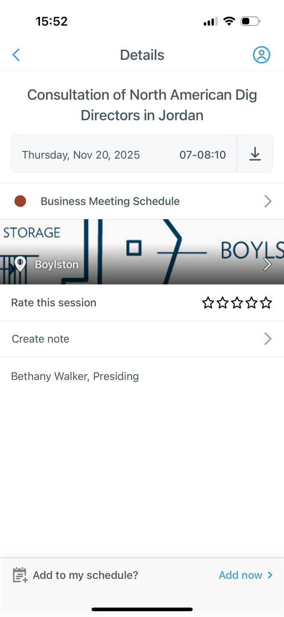
Business Meeting Schedule
The Business Meeting Schedule is where specific committees, receptions, and meetings can be viewed
Like the Academic Program, it is also navigable by date, and is organized chronologically
View the vents by clicking on them, same as the Academic Program
Once an event is selected, the title, date, location, and time will populate along with other additional information

Slide 12
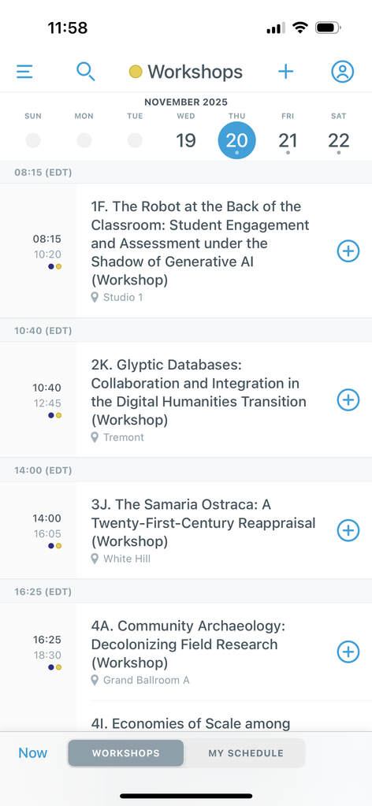
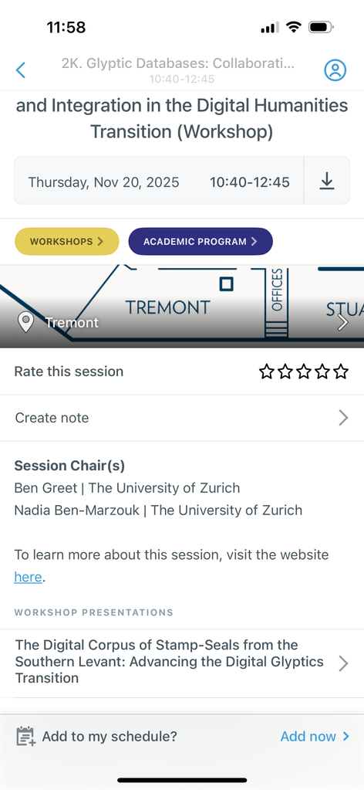
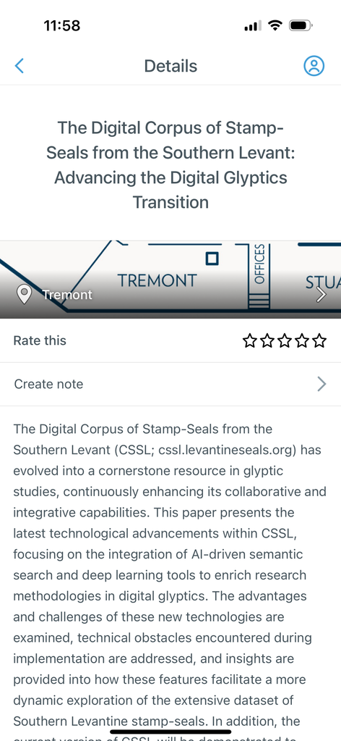
Workshop Presentations
The Workshops section is where all the workshop sessions are listed
They are also listed under “Academic Program“
View the session and presentations the same way as shown with the “Academic Program”
Important: no times are listed for individual presentations in workshops

Slide 13
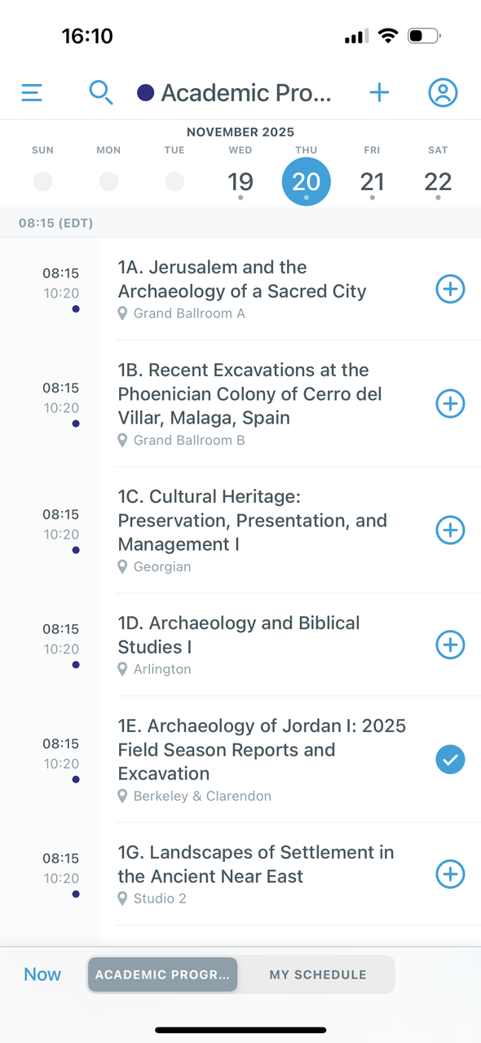
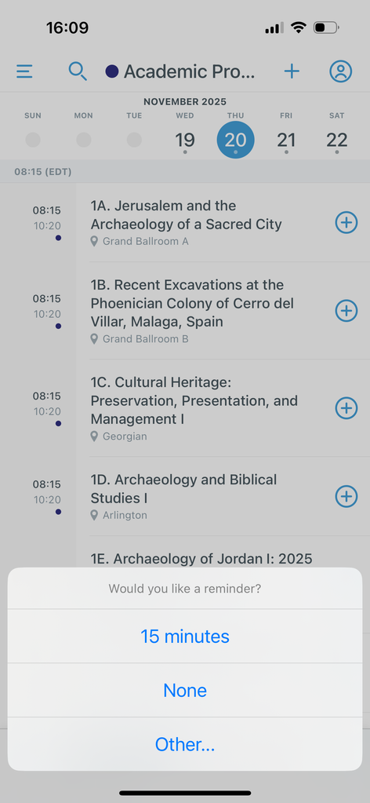
My Schedule
To add any session, presentation, workshop, or business meeting to your personal schedule click the ⨁ next to the item of interest
A pop up will appear at the bottom of your screen asking you if you would like to set a reminder for the session, if you would select 15 minutes to be reminded 15 minutes before the session or other if you would like a different time
When it is added, the session will display a colored-in check

Slide 14
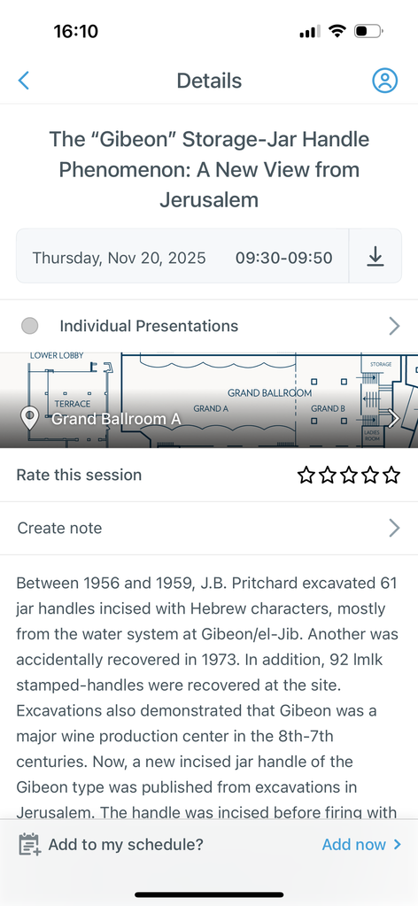
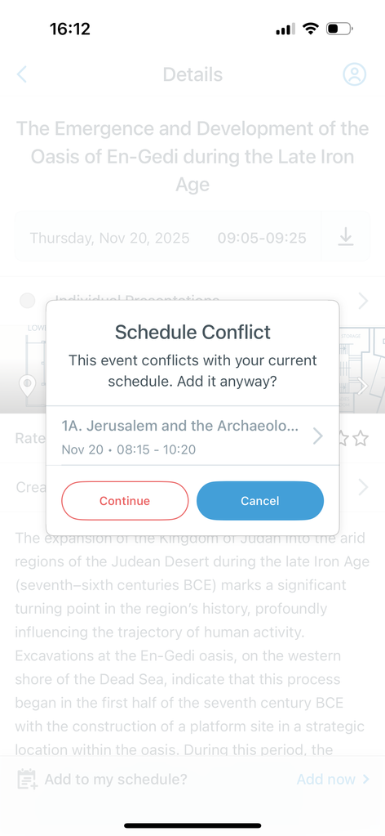
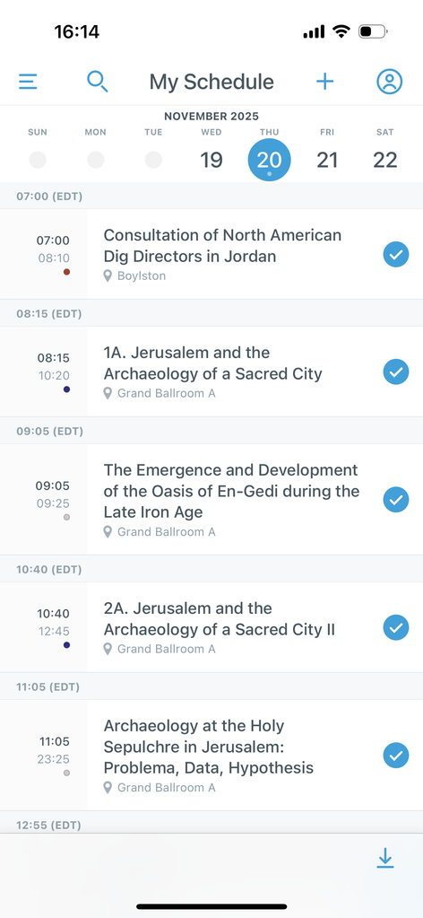
My Schedule
At the bottom of individual presentations, click “Add now” to add that presentation to “My Schedule”
If you have also added the session the individual presentation is in to your schedule a pop up will come up telling you that there is a schedule conflict, just click the continue button
You can view your schedule either by selecting “My Schedule” in the menu or by clicking on the tab at the bottom right when you have a calendar open
This will include all academic sessions, workshops, individual presentations, and business meetings you are attending
View of “My Schedule”

Slide 15
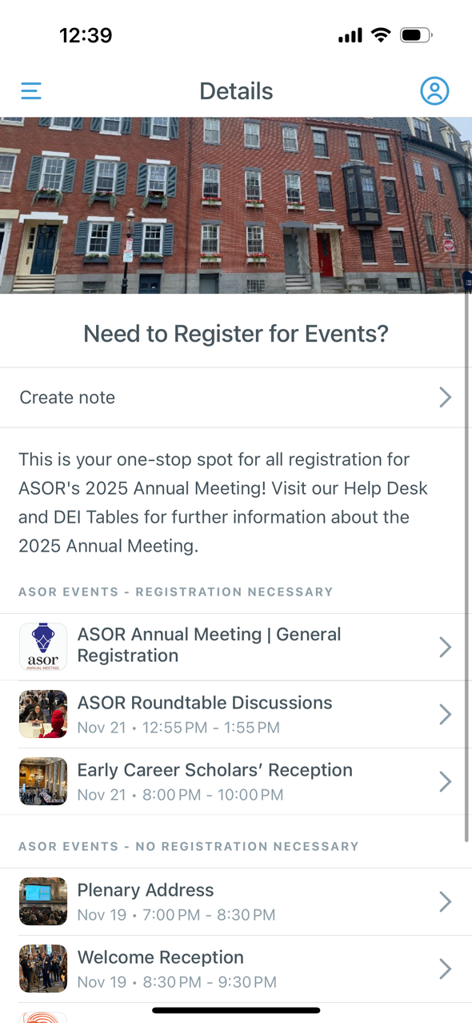
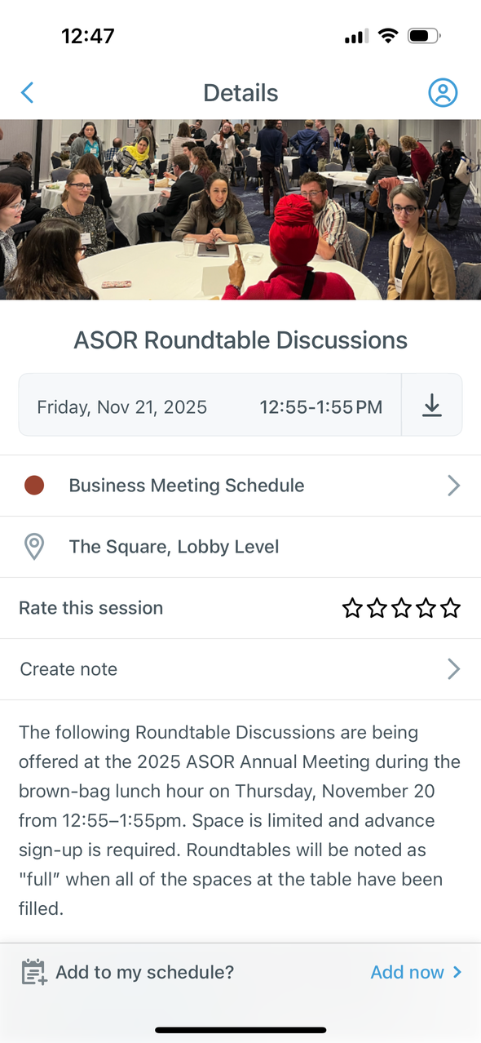
Need to Register for Events?
This page is the hub for all ASOR events that either do or do not require registration
Each individual page has information on how/where users can sign up for events
For example, ECS Reception requires signing up (Just adding it to your schedule DOES NOT register you! Please sign up with the forms provided!)
For events that do not require registration, additional information is also provided here

Slide 16
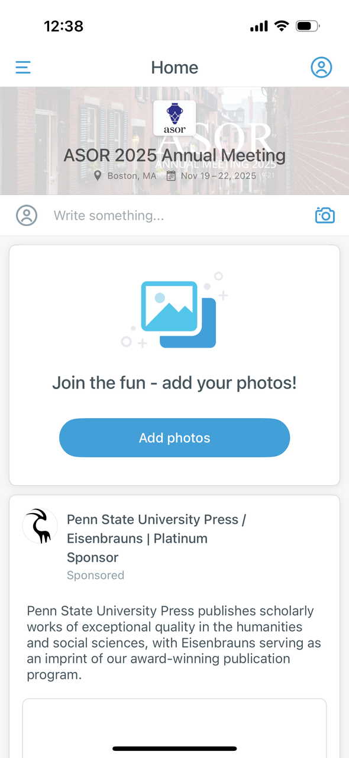
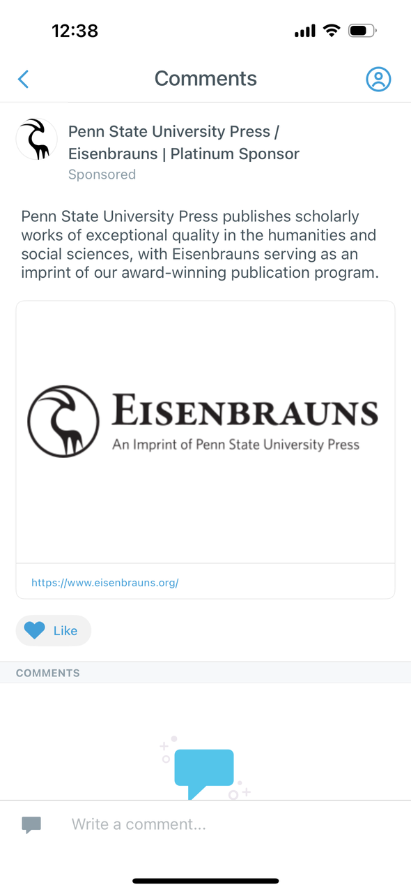
Meet our Sponsors
This page opens to a screen named “Home”
Here, users can upload photos with sponsors, view recent notifications, and see a list of 2025 Annual Meeting Sponsors
When clicking on a Sponsor, a brief description, link to their site, and a like & commentary section will appear
Likes and comments are public to all attendees

Slide 17
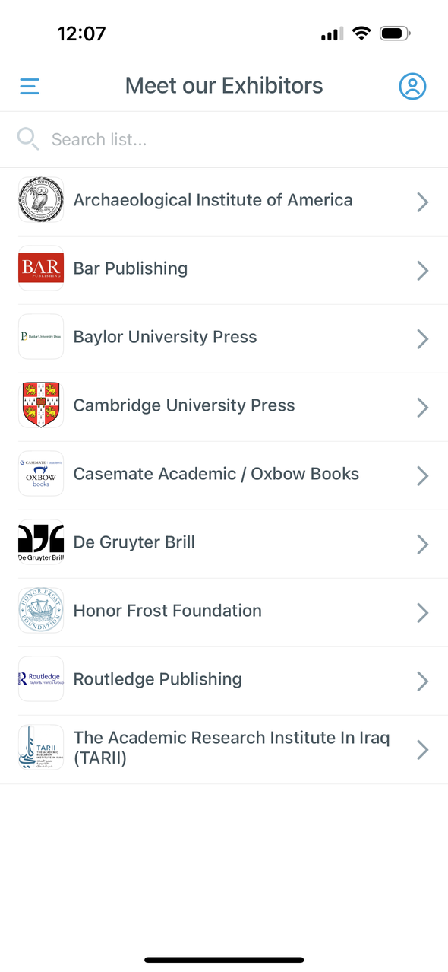

Meet our Exhibitors
This page contains a list of all exhibitors at the 2025 Annual Meeting
Click on an organization to read more about them!

Slide 18
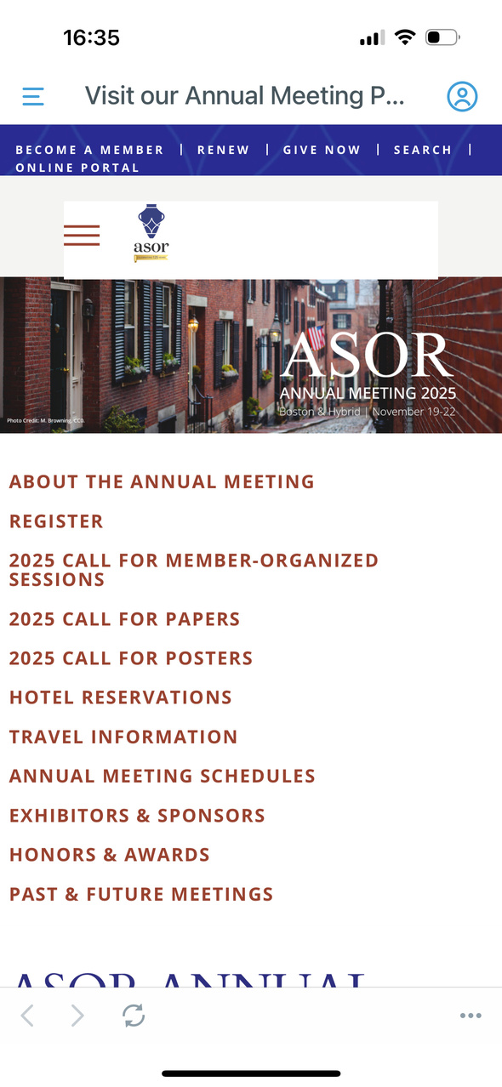
Visit our Annual Meeting Page
This will redirect the suer to ASOR’s landing page for the Annual Meeting website

Slide 19
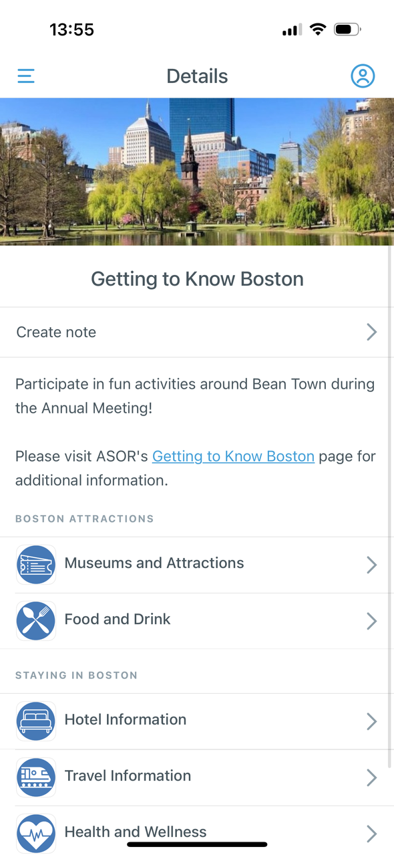
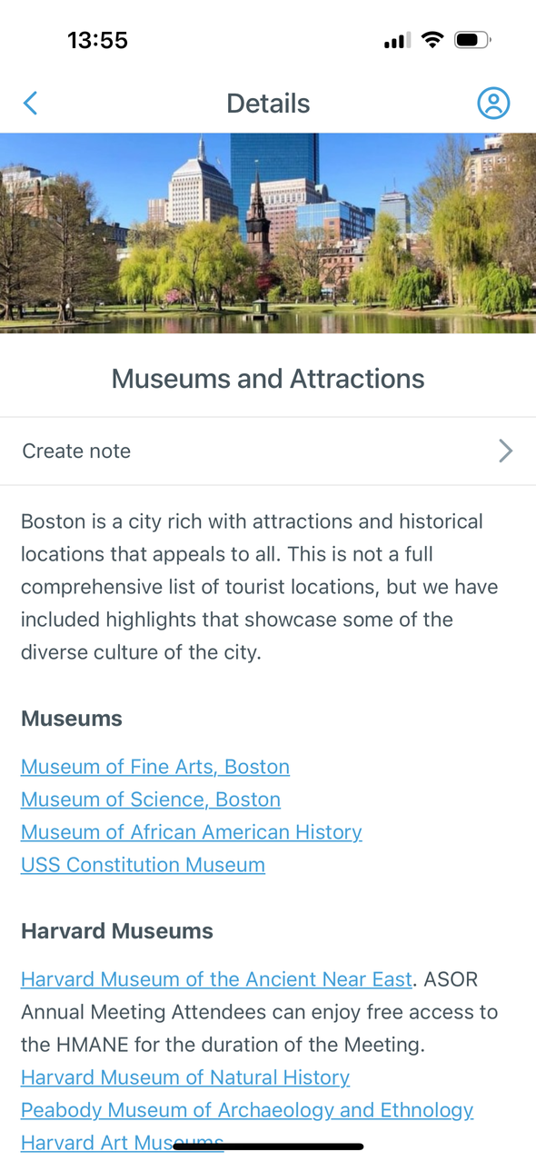
Getting to Know Boston
Here is various hotel, travel, and health information as well as a activity suggestions to help users learn more about the city of Boston
Click on any of the tabs to pull up information about events, booking hotels, or travel

Slide 20
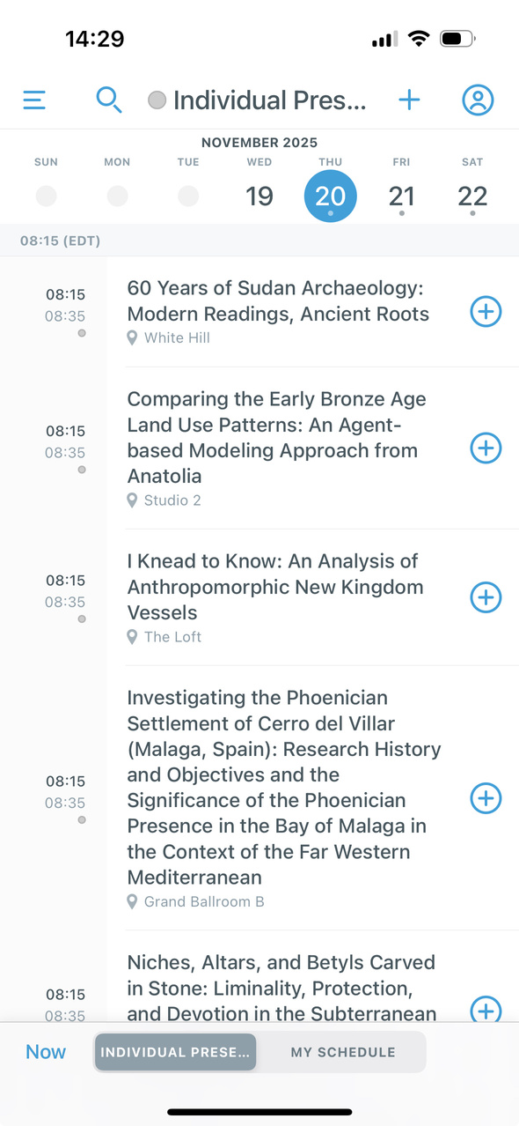
Individual Presentations
This page contains a list of all presentations at the 2025 Annual Meeting
Workshop presentations can be found under that tab
For a more organized list, please view the presentations in the “Academic Schedule”
View the information in the individual presentations by clicking on it
Add presentations and view information in the same fashion as “Academic Schedule”

Slide 21
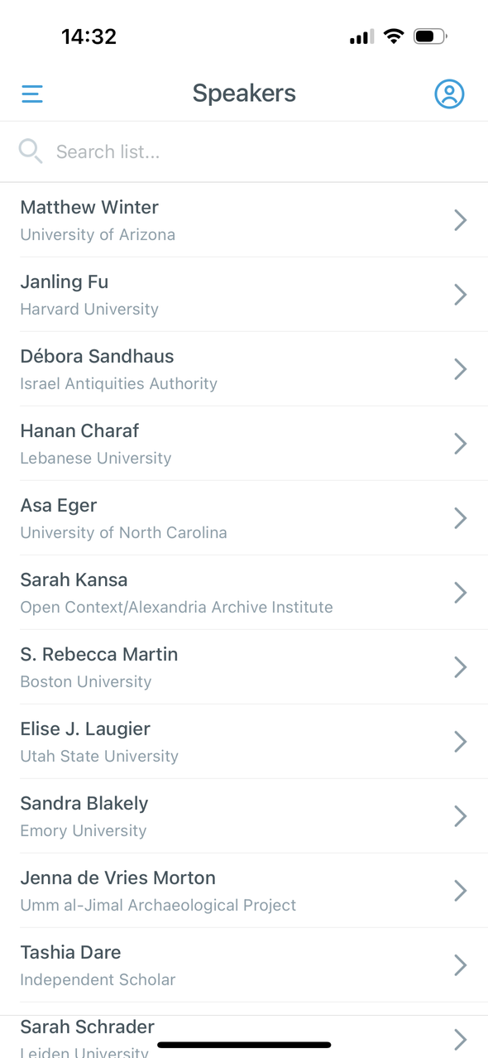
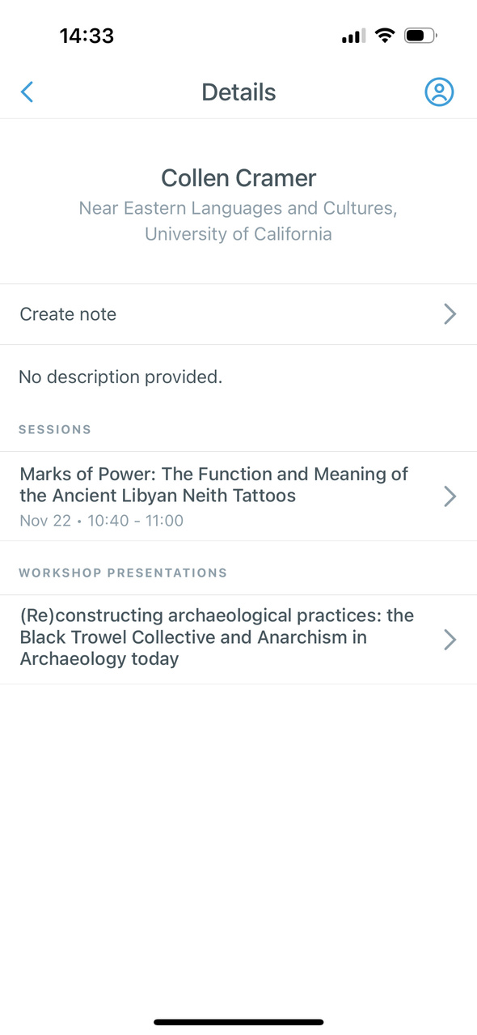
Speakers
This lists every presenter, author, and co-author of a presentation at the 2025 Annual meeting (affiliation is also listed)
View which presentations the speakers are participating in by clicking on their name

Slide 22
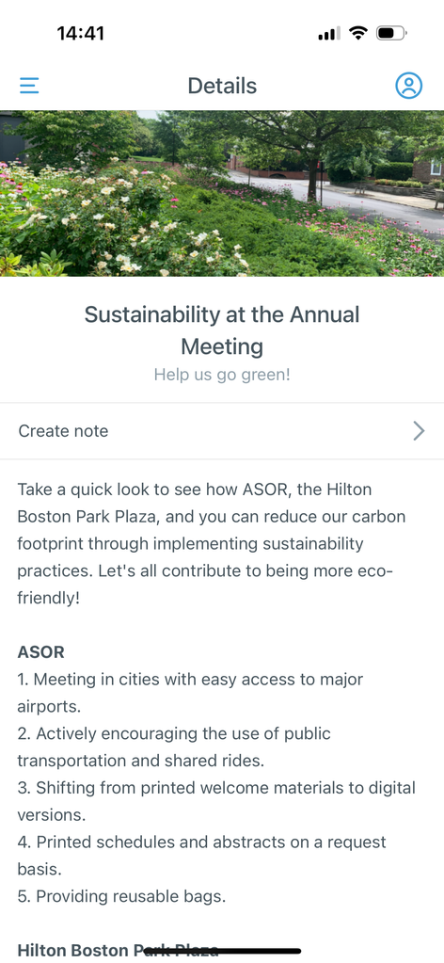
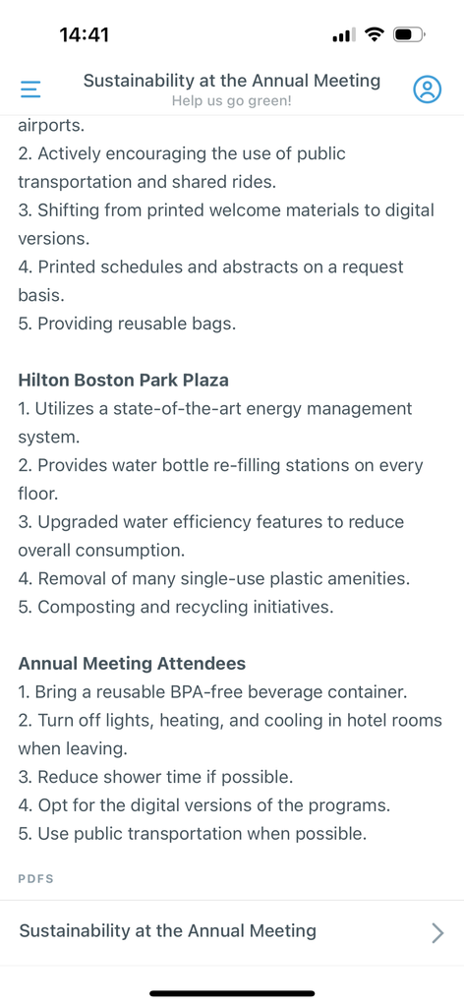
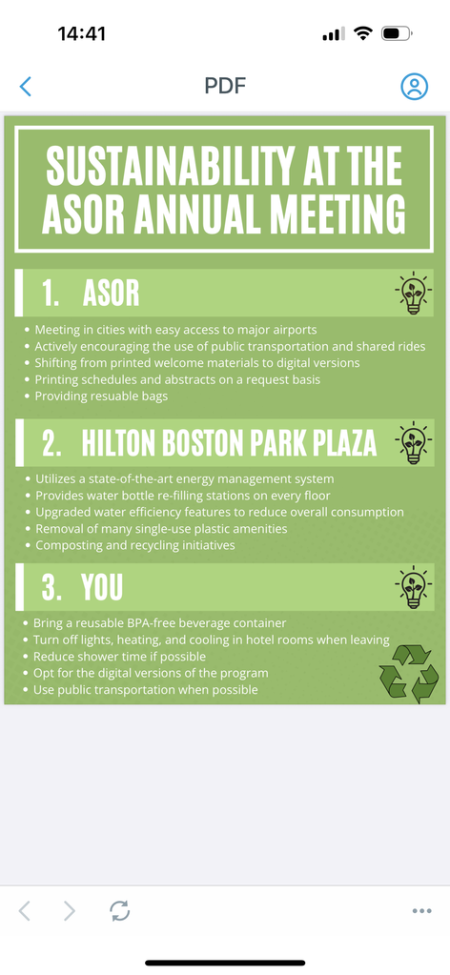
Sustainability at the Annual Meeting
Click here to read about efforts made by the Hilton Boston Park Plaza and the Annual Meeting to go green
There are also eco-friendly ways for all users to help the planet at the Annual Meeting
A PDF of all the information listed can be found at the bottom on the page

Slide 23
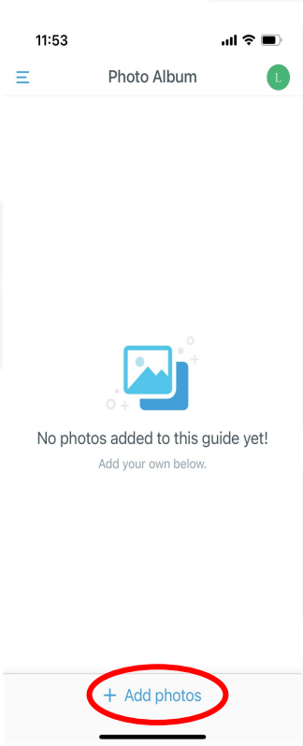
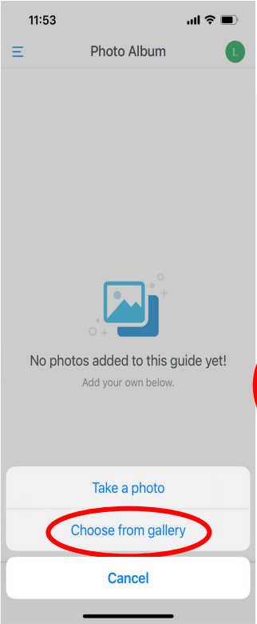
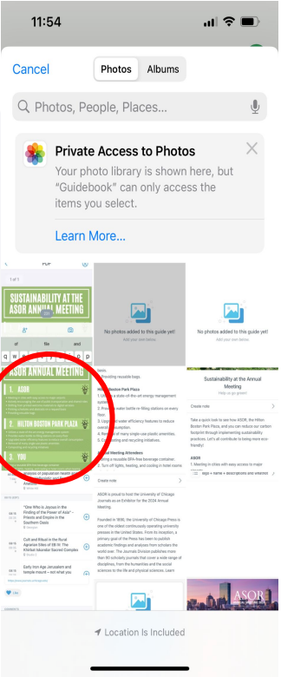
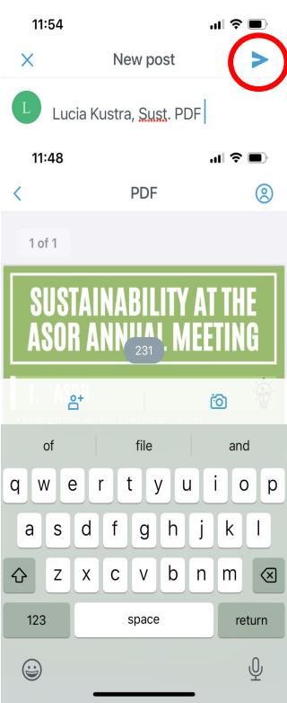
Photo Album
Upload photos you took at the Annual Meeting
To upload, click “Add Photos”
Take a photo
Choose from gallery → upload a pre-taken photo
Please caption your photo with your name and the event in the photo
Ex: Lucia Kustra, Sust. PDF

Slide 24
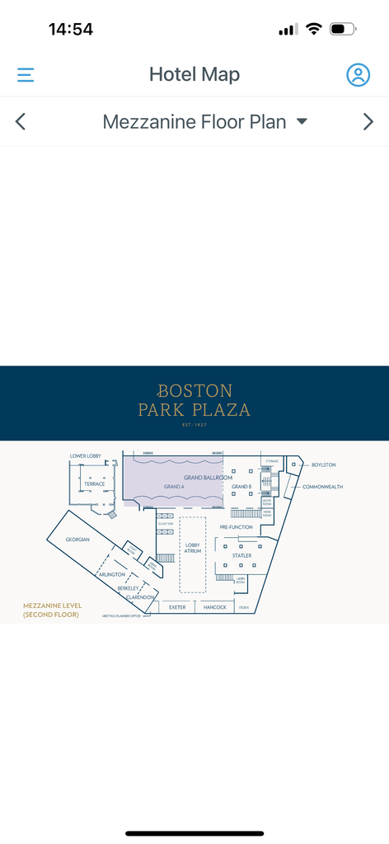
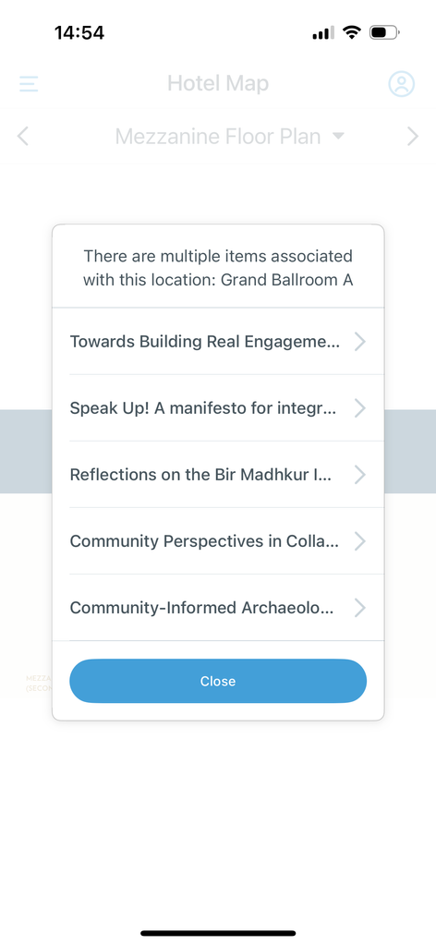
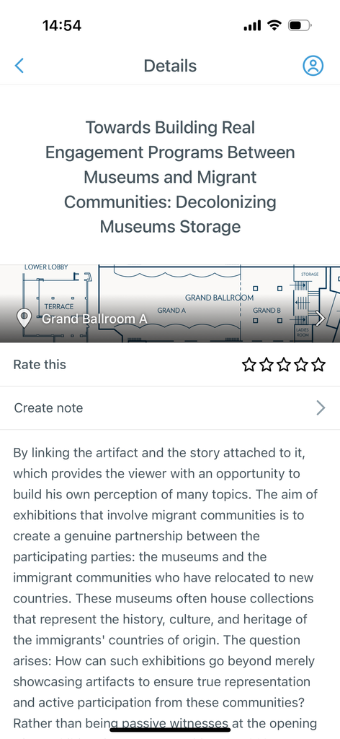
Hotel Maps
The three floors of the Hilton Boston Park Plaza are uploaded here
Clicking on a location will pull up all the sessions and presentations at that location
Click on the arrow on the right/left to switch between maps
Maps are also accessible within sessions and presentations
Click on the map to see a zoomed-in view to assist in navigating the hotel

Slide 25
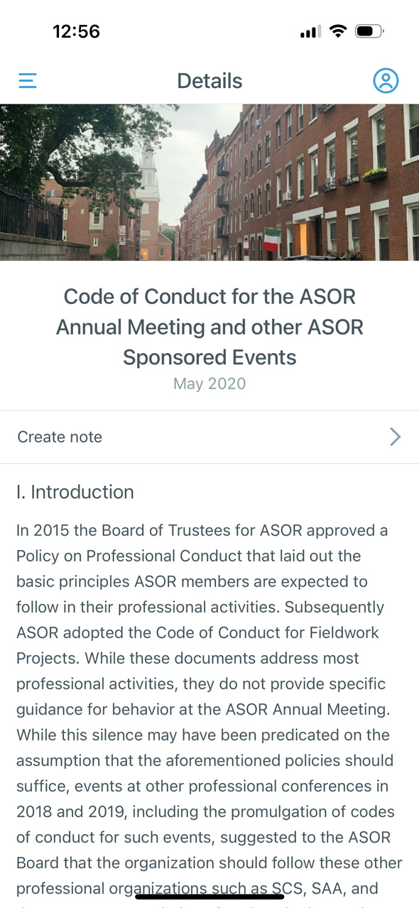
Code of Conduct
This page contains a link to ASOR’s Code of Conduct for all events, members, attendees, and employees
Click on the link to read further

Slide 26
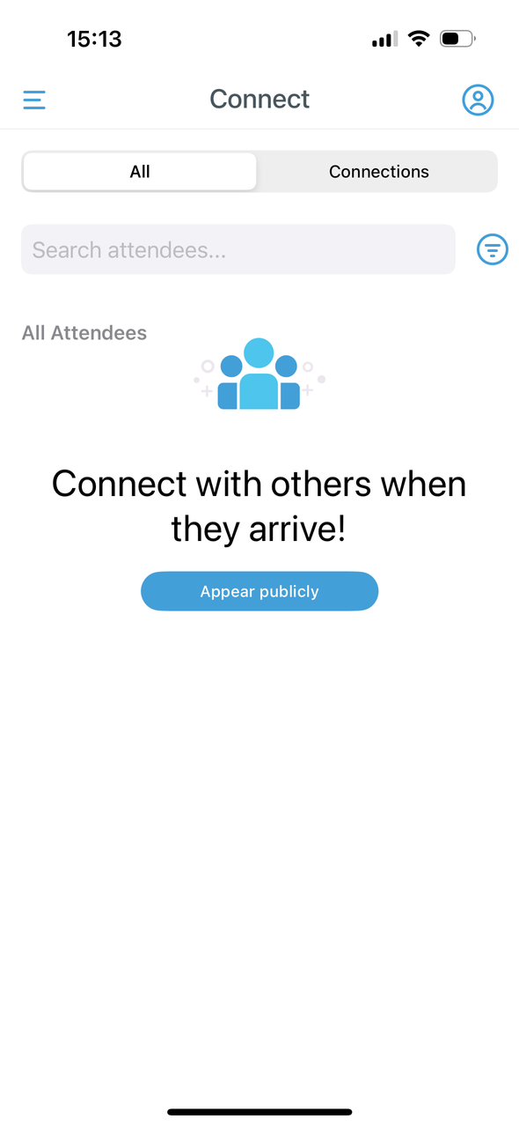

Connect
This page allows users to connect to other registered members on the Guidebook app
If you have not downloaded the Guidebook app before you will be asked to appear publicly, click on the blue button that says “Appear publicly” and select that option
Click on “Add” to connect
Search for attendees in the search box above

Slide 27


Notes
This page allows users to take notes digitally
Click on (+) Create note and start typing

Slide 28
More questions?
Please reach out to us!
We look forward to hosting you in November!

